Slide 1







Towards Robust Metrics For Concept Representation Evaluation
Mateo Espinosa Zarlenga*
University of Cambridge
me466@cam.ac.uk
Pietro Barbiero*
University of Cambridge
pb737@cam.ac.uk
Zohreh Shams*
Babylon Health
University of Cambridge
zs315@cam.ac.uk
Dmitry Kazhdan
University of Cambridge
dk525@cam.ac.uk
Umang Bhatt University of Cambridge The Alan Turing Institute
usb20@cam.ac.uk
Adrian Weller University of Cambridge The Alan Turing Institute
aw665@cam.ac.uk
Mateja Jamnik University of Cambridge
mateja.jamnik@cl.cam.ac.uk
AAAI 2023
Washington DC, USA

Slide 2
Motivation

Slide 3

From XAI to Concept-based XAI
Image taken from Espinosa Zarlenga et al., “Concept Embedding Models.” NeurIPS (2022)

Slide 4
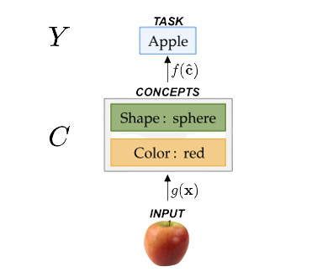
High-level Concepts as Explanations
Concept-based XAI aims to construct explanations for a deep neural network using a set of human-understandable high-level concepts
Image taken from Espinosa Zarlenga et al., “Concept Embedding Models.” NeurIPS (2022)

Slide 5
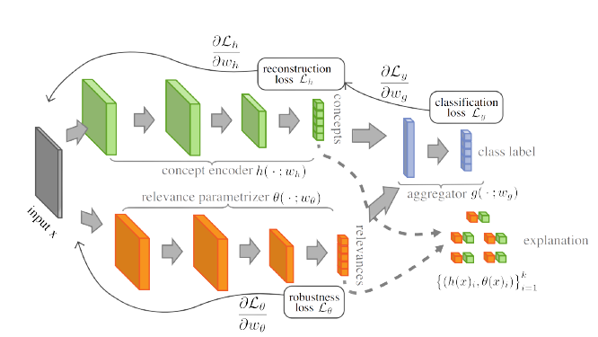
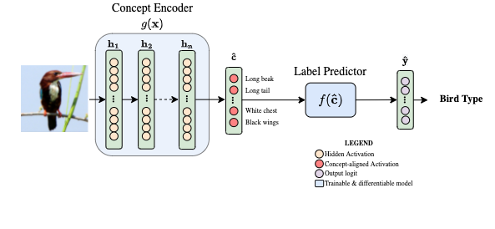
Explaining with high-level concepts
Traditionally this is achieved via two different paths:
1. Concept-supervised (e.g., Concept Bottleneck Models [1])
2. Concept-unsupervised (e.g., Self-Explainable Neural Networks [2])
[1] Koh, Pang Wei, et al. "Concept bottleneck models." ICML (2020)
[2] Alvarez Melis et al. "Towards robust interpretability with self-explaining neural networks." NeurIPS (2018)

Slide 6
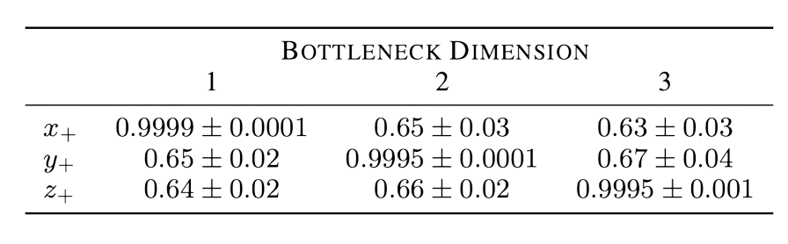
Why new concept representation metrics?
We argue that new concept-specific quality metrics are needed because:
1. Previous work by Mahinpei et al. [1] suggests that traditional concept learning methods may be encoding unnecessary information as part of their concept representations
Table: predictive power of each learnt concept representation for each ground truth concept label
[1] Mahinpei et al., “Promises and Pitfalls of Black-Box Concept Learning Models.” ICML (2021)

Slide 7
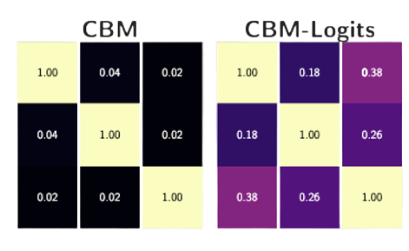
Why new concept representation metrics?
We argue that new concept-specific quality metrics are needed because:
2. Metrics used in concept learning can’t capture effects related to impurities in concepts
Figure: Absolute Pearson correlation coefficients between learnt concept representations of two CBMs.

Slide 8
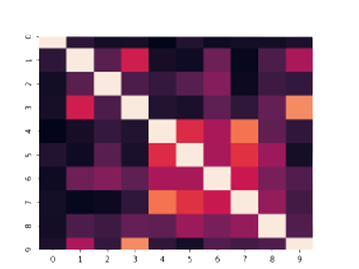
Why new concept representation metrics?
We argue that new concept-specific quality metrics are needed because:
3. Existing metrics in related fields (e.g., disentanglement learning), assume independence across different ground truth concepts. This assumption fails to hold in real-world tasks.
Figure: Pearson correlation coefficients in top-10 concepts in CUB

Slide 9
Measuring Concept Quality

Slide 10
Measuring Quality of Concepts
We measure a concept representation’s quality by quantifying how much ”unnecessary” information it encodes about a set of known ground-truth concepts.

Slide 11
Measuring Quality as Concept Purity: OIS
The Oracle Impurity Score (OIS) focuses on measuring impurities localized within a single concept representation.

Slide 12






Measuring Quality as Concept Purity: OIS
We measure how accurately we can predict a concept from a learnt concept representation and evaluate how this diverges from what we expect from their ground-truth concepts.
Ground Truth Concepts
Ground Truth Concepts
Ground Truth Concepts
1.0
0.5
0.5
1.0
0.5
0.5
1.0
0.7
0.9
0.5
1.0
0.5
1.0
1.0
0.6
0.7
1.0
0.5
Ground Truth Concepts
Learnt Concepts
Learnt Concepts
0.5
0.5
1.0
1.0
0.6
1.0
0.5
0.5
1.0
Predictive Accuracy (Oracle Matrix)
Low OIS
High OIS
0.5
“Can we predict a concept c from learnt concept representation c’ better than what we expect from their respective ground truths labels?”

Slide 13
Measuring Quality as Concept Purity: NIS
The Niche Impurity Score (NIS) focuses on measuring impurities distributed across multiple concept representations.

Slide 14
Measuring Quality as Concept Purity: NIS
We measure whether sets of concept representations that are uncorrelated with a given ground truth concept can accurately predict that concept:
Ground Truth Concepts
Yes
High NIS
1.0
0.4
0.0
0.0
0.4
1.0
0.1
Can accurately predict ?
Learnt Concepts
0.1
0.1
0.2
1.0
1.0
Low NIS
Absolute Pearson Correlation Matrix
No
“How well can we predict a concept c from a subset of concept representations uncorrelated with c?”

Slide 15
Results

Slide 16
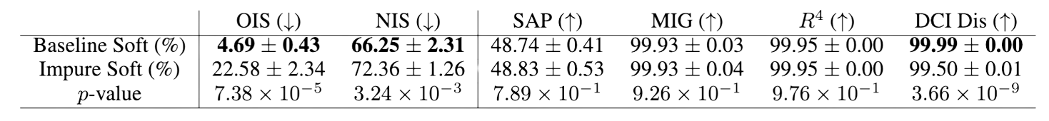
Capturing previously undetected impurities
Our metrics can capture impurities that are undetected by existing metrics
We do this by observing that our metrics produce significantly different results when evaluated on
a. Perfectly pure “soft” representations (i.e., our baseline), and
b. Perfectly impure “soft” representations
Our metrics
Traditional disentanglement learning metrics

Slide 17
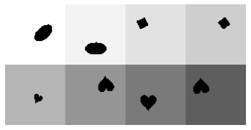
Can we detect impurities due to spurious correlations?
Consider training a two CBMs:
1. “CBM-S” is trained on a corrupted dSprites task with spurious label correlations
2. “CBM” is trained on the uncorrupted dSprites task (no spurious correlation).
Notes:
A model may accidentally learn spurious correlations in its training set and encode them as part of its learnt concept representations.

Slide 18
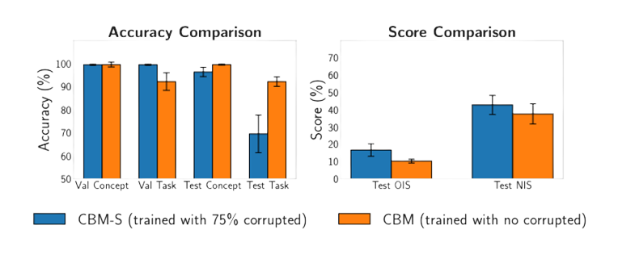
Can we detect impurities due to spurious correlations?
Consider training a two CBMs:
1. “CBM-S” is trained on a corrupted dSprites task with spurious label correlations
2. “CBM” is trained on the uncorrupted dSprites task (no spurious correlation).
Notes:
A model may accidentally learn spurious correlations in its training set and encode them as part of its learnt concept representations.
Key takeaway: our metrics can be used to identify possible spurious correlations captured in concept representations.

Slide 19
Can we detect impurities due to spurious correlations?
Consider training a two CBMs:
1. “CBM-S” is trained on a corrupted dSprites task with spurious label correlations
2. “CBM” is trained on the uncorrupted dSprites task (no spurious correlation).
Notes:
A model may accidentally learn spurious correlations in its training set and encode them as part of its learnt concept representations.
Key takeaway: our metrics can be used to identify possible spurious correlations captured in concept representations.

Slide 20
Can we detect impurities due to spurious correlations?
Consider training a two CBMs:
1. “CBM-S” is trained on a corrupted dSprites task with spurious label correlations
2. “CBM” is trained on the uncorrupted dSprites task (no spurious correlation).
Notes:
A model may accidentally learn spurious correlations in its training set and encode them as part of its learnt concept representations.
Key takeaway: our metrics can be used to identify possible spurious correlations captured in concept representations.

Slide 21
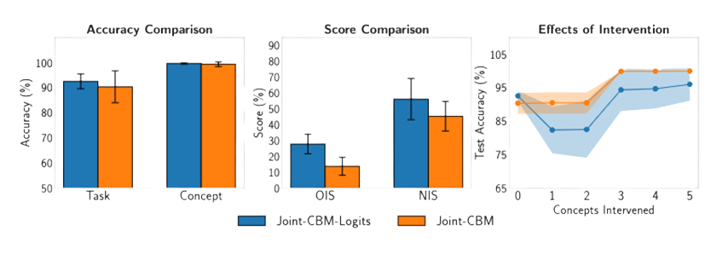
Effects of impurities on concept interventions
Impurities can affect how test-time concept interventions fare in concept bottleneck models!

Slide 22
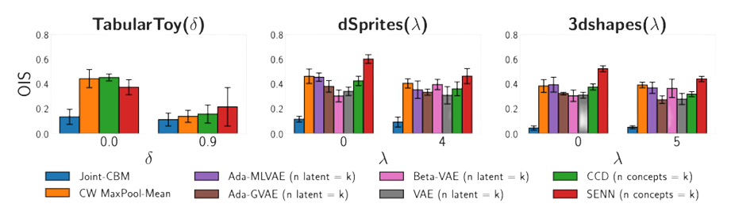
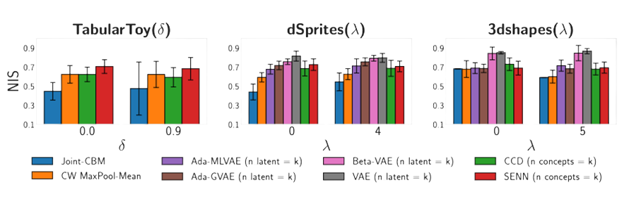
Benchmarking Concept Learning Models
We compare the quality of concepts learnt across a variety of methods and datasets.
Notes:
We compare and contrast the quality of concept representations learnt by a vast number of concept learning and disentanglement learning methods across multiple datasets and show that full concept supervision alone is not sufficient to ensure that learnt concept representations are pure.
Show that full concept supervision alone is not sufficient to ensure that learnt concept representations are pure.
We evaluate all methods in three parametric datasets with known sets of ground-truth binary concepts. In each datasets, the parameter, shown in the x-axis, is directly proportional to how correlated ground-truth concepts are in each tasks.
Concept-supervision != better localized purity as seen by CW vs DGL methods and CCD
Similarly, task supervision != better localized purity as seen by SENN vs DGL methods

Slide 23
Key findings and significance
In this work we:
Propose two novel metrics to evaluate the quality of learnt concept representations.
Show that our metrics can be used to detect impurities that are (1) concealed in soft representations, (2) caused by different model capacities, and (3) caused by accidental spurious correlations.
Demonstrate the possible effect that impurities may have in concept interventions, and
Quantitively explore how concept supervision affects concept purity across multiple methods and datasets.
Notes:
In this work we:
Propose two novel metrics to evaluate the quality of learnt concept representations.
Show that our metrics can be used to detect impurities (i) concealed in soft representations, (ii) caused by different model capacities or by spurious correlations.
Demonstrate the possible effect that impurities may have in concept interventions, and
Quantitively explore the impact of concept supervision on concept purity and confirm qualitative results suggesting that concept supervision alone may not be enough to guarantee concept purity.

Slide 24

For more results, discussions, and details visit us during our poster (#113)!
Link to paper + code!

